Slide 1
Paperless
Towards
Step
First
Office

Slide 2


Library Book Issue and Return Record Maintaining System
Created By Mr. Dhvanil Patel, Student of M.Sc. Applied Statistics Batch 2021-23

Slide 3
Library Book Issue and Return Record Maintaining System
Created By Mr. Dhvanil Patel, Student of M.Sc. Applied Statistics Batch 2021-23
Why to switch over this system?

Slide 4

Till now we are using offline manual book register for book Issue and Return.
Why to switch over this system?
Problems :-
Problem is being faced by both Students and Management
Students
One Student had to wait until next student issues his/her book.
At the time of returning book student need to manually find record of that particular date with his/her name.
Management
Management had to do all the calculation manually whenever any information required.
As for example at the end of year how many books were issued?
Which book was issued the most ?
By this management can decide which book is most demanded and can increase number of that books so that any future shortage of that books can avoided.
How to solve these problems ?

Slide 5

Advantages
How to solve these problems ?
I created this system fully online using Google Form and Google Sheets
There are two forms
Book Issue Form
Book Return Form
Google Sheet fetch live data from these google forms.
Student gets E-mail immediately after issuing book as proof of issuing partiture book
Student will receive an Reminder E-mail after 14 days of issuing book.

Slide 6
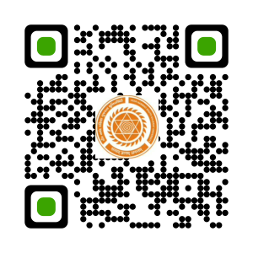
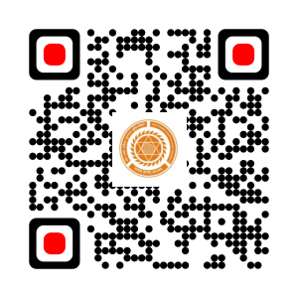
All student can fill this form together concurrently.
Advantages
All student gets immediate E-Mail of issued book with as a proof of issuing book
From this E-Mail student get details about on which date student issued which book.
Person who issued book also gets Reminder as an E-Mail after 14 Days of Book Issue if book is not being returned in 14 Days time period.
For Management this system results in very easy retrieval of data whenever needed, as this data is now being stored in Excel Sheet rather then Offline manual Register.
This would be an advantage that student will return book on time as they are getting reminder E-mail.
Thus, this system becomes Easy for Student and Management both
Demo
Book Issue
Book Return

Slide 7

Any Questions?
Book Issue
Book Return
Demo

Slide 8
Any Questions?
Book Issue
Book Return
Demo

Slide 9
Any Questions?

Slide 10
Thank You…

Slide 11
Thank You…

